Slide 1
UNIVERSAL MOBILE TELECOMMUNICATION SYSTEM

Slide 2
3G
3G Systems are intended to provide a global mobility with wide range of services including telephony, paging, messaging, Internet and broadband data.
International Telecommunication Union (ITU) started the process of defining the standard for third generation systems, referred to as International Mobile Telecommunications 2000 (IMT-2000).
In Europe European Telecommunications Standards Institute (ETSI) was responsible of UMTS standardisation process.
In 1998 Third Generation Partnership Project (3GPP) was formed to continue the technical specification work.
3GPP has five main UMTS standardisation areas: Radio Access Network, Core Network, Terminals, Services and System Aspects and GERAN(GSM EDGE Radio Access Network).

Slide 3
UMTS SERVICES
UMTS offers teleservices (like speech or SMS) and bearer services, which provide the capability for information transfer between access points.
It is possible to negotiate and renegotiate the characteristics of a bearer service at session or connection establishment and during ongoing session or connection.
Both connection oriented and connectionless services are offered for Point-to-Point and Point-to-Multipoint communication.
Bearer services have different QoS parameters for maximum transfer delay, delay variation and bit error rate.
Offered data rate targets are:
144 kbits/s satellite and rural outdoor
384 kbits/s urban outdoor
2048 kbits/s indoor and low range outdoor

Slide 4
UMTS SERVICES
UMTS network services have different QoS classes for four types of traffic:
Conversational class (voice, video telephony, video gaming)
Streaming class (multimedia, video on demand, webcast)
Interactive class (web browsing, network gaming, database access)
Background class (email, SMS, downloading)
UMTS will also have a Virtual Home Environment (VHE). It is a concept for personal service environment portability across network boundaries and between terminals. Personal service environment means that users are consistently presented with the same personalised features, User Interface customisation and services in whatever network or terminal, wherever the user may be located. UMTS also has improved network security and location based services.

Slide 5
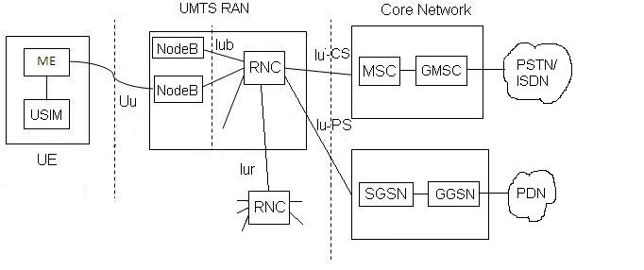
UMTS NETWORK ARCHITECTURE

Slide 6
SYSTEM ARCHITECTURE
There are three main components in UMTS network architecture,
User Equipments is composed of Mobile Equipment (ME) and USIM.
Radio Access Network is composed of NodeB and RNC.
Core Network is composed of circuit switched and packet switched functional modules.
For Circuit switched (CS) operations MSC and GMSC along with database modules such as VLR, HLR will be available.
For packet switched (PS) operations SGSN and GGSN will serve the purpose.
GMSC will be connected with PSTN/ISDN in CS case.
GGSN is connected with Packet data Network (PDN) for PS case.

Slide 7
SYSTEM ARCHITECTURE
Functional network elements
  User Equipment (UE)
    interfaces with user and radio interface
  Radio Access Network (RAN, UMTS Terrestrial RAN = UTRAN)
    handles all radio-related functionality
  Core Network
    switches and routes calls and data connections to external networks

Slide 8
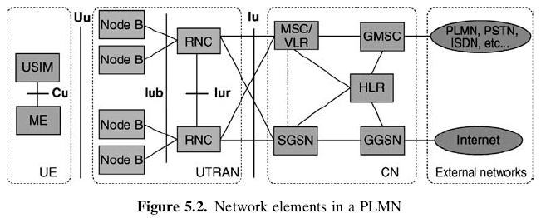
UE consists of two parts
  Mobile Equipment (ME)
    the radio terminal used for radio communication over Uu interface
  UMTS Subscriber Identity Module (USIM)
    a smartcard that holds the subscriber identity
    performs authentication algorithms
    stores authentication and encryption keys
    some subscription information that is needed at the terminal

Slide 9
UE consists of two parts
  Mobile Equipment (ME)
    the radio terminal used for radio communication over Uu interface
  UMTS Subscriber Identity Module (USIM)
    a smartcard that holds the subscriber identity
    performs authentication algorithms
    stores authentication and encryption keys
    some subscription information that is needed at the terminal

Slide 10
UTRAN consists of two elements
  Node B
    converts data flow between Iub and Uu interfaces
    participates in radio resource management
  Radio Network Controller (RNC)
    owns and controls radio resources in its domain
    the service access point (SAP) for all services that UTRAN provides the CN
      e.g., management of connections to UE

Slide 11
Main elements of CN
  HLR (Home Location Register)
  MSC/VLR (Mobile Services Switching Centre/Visitor Location Register)
  GMSC (Gateway MSC)
  SGSN (Serving GPRS (General Packet Radio Service) Support Node)
  GGSN (Gateway GPRS Support Node)

Slide 12
(a) HLR (Home Location Register)
  a database located in user’s home system that stores the master copy of user’s service profile
  service profile consists of, e.g.,
    information on allowed services, forbidden roaming areas
    supplementary service information such as status of call forwarding and the call forwarding number

Slide 13
  it is created when a new user subscribes to the system, and remains stored as long as the subscription is active
  for the purpose of routing incoming transactions to UE (e.g. calls or short messages)
    HLR also stores the UE location on the level of MSC/VLR and/or SGSN

Slide 14
(b) MSC/VLR (Mobile Services Switching Centre/Visitor Location Register)
  the switch (MSC) and database (VLR) that serve the UE in its current location for Circuit Switched (CS) services
  the part of the network that is accessed via MSC/VLR is often referred to as CS domain
  MSC
    used to switch CS transactions
  VLR
    holds a copy of the visiting user’s service profile, as well as more precise information on the UE’s location within the serving system

Slide 15
(c) GMSC (Gateway MSC)
  the switch at the point where UMTS PLMN is connected to external CS networks
  all incoming and outgoing CS connections go through GMSC

Slide 16
(d) SGSN (Serving GPRS (General Packet Radio Service) Support Node)
  functionality is similar to that of MSC/VLR but is typically used for Packet Switched (PS) services
  the part of the network that is accessed via SGSN is often referred to as PS domain
(e) GGSN (Gateway GPRS Support Node)
  functionality is close to that of GMSC but is in relation to PS services

Slide 17
External networks can be divided into two groups
  CS networks
    provide circuit-switched connections, like the existing telephony service
    ISDN and PSTN are examples of CS networks
  PS networks
    provide connections for packet data services
    Internet is one example of a PS network

Slide 18
Interfaces between these entities are summarized below.
Uu interface between UE and NodeB
Iub interface between NodeB and RNC
Iur interface between RNC and RNC
Iu-CS interface between RNC and MSC
Iu-PS interface between RNC and SGSN

Slide 19
Main open interfaces
  Cu interface
    the electrical interface between USIM smartcard and ME
  Uu interface
    the WCDMA radio interface
    the interface through which UE accesses the fixed part of the system
    the most important open interface in UMTS

Slide 20
  Iu interface
    connects UTRAN to CN
  Iur interface
    allows soft handover between RNCs
  Iub interface
    connects a Node B and an RNC

Slide 21
UTRAN(UNIVERSAL TERRESTRIAL RADIO ACCESS NETWORK)
UTRAN (short for "Universal Terrestrial Radio Access Network") is a collective term for the network and equipment that connects mobile handsets to the public telephone network or the Internet.
It contains the base stations, which are called Node B's and Radio Network Controllers (RNCs) which make up the UMTS radio access network.
This communications network, commonly referred to as 3G (for 3rd Generation Wireless Mobile Communication Technology), can carry many traffic types from real-time Circuit Switched to IP based Packet Switched.
The UTRAN allows connectivity between the UE (user equipment) and the core network.

Slide 22
UTRAN(UNIVERSAL TERRESTRIAL RADIO ACCESS NETWORK)
The RNC provides control functionalities for one or more Node Bs.
A Node B and an RNC can be the same device, although typical implementations have a separate RNC located in a central office serving multiple Node Bs.
Despite the fact that they do not have to be physically separated, there is a logical interface between them known as the Iub.
The RNC and its corresponding Node Bs are called the Radio Network Subsystem (RNS).
There can be more than one RNS present in a UTRAN.

Slide 23
UTRAN(UNIVERSAL TERRESTRIAL RADIO ACCESS NETWORK)
There are four interfaces connecting the UTRAN internally or externally to other functional entities: Iu, Uu, Iub and Iur.
The Iu interface is an external interface that connects the RNC to the Core Network (CN).
The Uu is also external, connecting the Node B with the User Equipment (UE).
The Iub is an internal interface connecting the RNC with the Node B.
And the Iur interface is an internal interface most of the time, but can, exceptionally be an external interface too for some network architectures. The Iur connects two RNCs with each other.

Slide 24
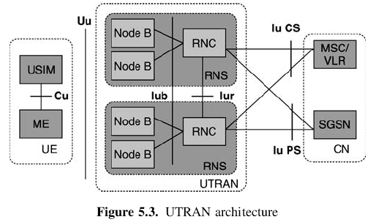
UTRAN ARCHITECTURE
Radio Network Controller
Node B (Base Station)

Slide 26
UTRAN
  consists of one or more Radio Network Sub-systems (RNS)
RNS
  a subnetwork within UTRAN
  consists of one Radio Network Controller (RNC) and one or more Node Bs

Slide 27
RADIO NETWORK CONTROLLER
RNC (Radio Network Controller)
  the network element responsible for radio resources control of UTRAN
  it interfaces CN (normally to one MSC and one SGSN)
  terminates RRC (Radio Resource Control) protocol that defines the messages and procedures between mobile and UTRAN
  it logically corresponds to the GSM BSC

Slide 28
LOGICAL ROLE OF THE RNC
The RNC controlling one Node B is indicated as the Controlling RNC (CRNC) of Node B
Controlling RNC
  responsible for load and congestion control of its own cells
  executes admission control for new radio links

Slide 29
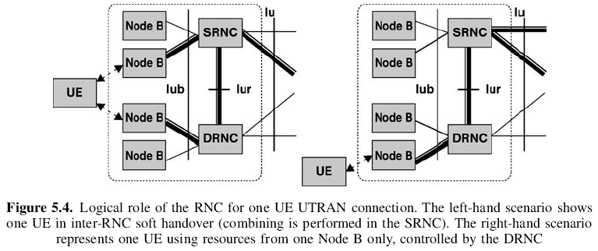
In case one mobile–UTRAN connection uses resources from more than one RNS (due to handover), the RNCs involved have two separate logical roles
  Serving RNC (SRNC)
  Drift RNC (DRNC)

Slide 31
NODE B (BASE STATION)
Main function of Node B
  perform the air interface L1 processing, e.g.,
    channel coding and interleaving
    rate adaptation
    spreading
  also performs some basic Radio Resource Management operations, e.g.
    inner loop power control
It logically corresponds to the GSM Base Station

Slide 32
INTERLEAVING
The transmission of pulses from two or more digital sources in time-division sequence over a single path

Slide 33
GENERAL PROTOCOL MODEL FOR UTRAN TERRESTRIAL INTERFACES
General
Horizontal Layers
Vertical Planes

Slide 34
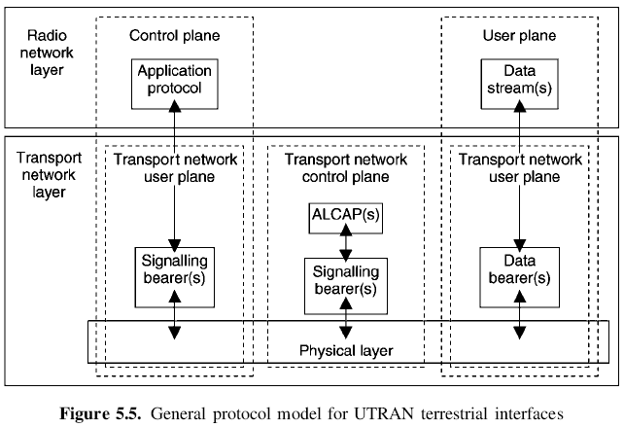
GENERAL
The general protocol model for UTRAN terrestrial interfaces
  the layers and planes are logically independent of each other
  parts of the protocol structure may be changed in the future while other parts remain intact

Slide 36
HORIZONTAL LAYERS
The protocol structure consists of two main layers
  Radio network layer
  Transport network layer

Slide 37
VERTICAL PLANES
Control Plane
User Plane
Transport Network Control Plane
Transport Network User Plane

Slide 38
CONTROL PLANE
Control Plane
  used for all UMTS-specific control signaling
  includes two parts
    application protocol
      RANAP (RAN application part) in Iu
      RNSAP (RNS application part) in Iur
      NBAP (Node B application part) in Iub
    signaling bearer
      transport the application protocol messages

Slide 39
Application protocol is used for
  setting up bearers to UE, i.e.
    radio access bearer in Iu
    radio link in Iur and Iub

Slide 40
USER PLANE
User Plane
  transport all information sent and received by the user, such as
    coded voice in a voice call
    packets in an Internet connection
  includes two parts
    data stream(s)
    data bearer(s) for data stream(s)

Slide 41
TRANSPORT NETWORK CONTROL PLANE
Used for all control signaling within transport layer
Does not include any radio network layer information
Includes ALCAP (Access Link Control Application Part) protocol used to set up the transport bearers (data bearer) for user plane

Slide 42
UMTS CORE NETWORK ARCHITECTURE AND EVOLUTION
Release’99 Core Network Elements
Release 5 Core Network and IP Multimedia Sub-system

Slide 43
Core Network
UMTS radio interface, WCDMA
  a bigger step in radio access evolution from GSM networks
UMTS core network
  did not experience major changes in 3GPP Release’99 specification
Release’99 structure was inherited from GSM core network
  both UTRAN and GERAN based radio access network connect to the same core network

Slide 44
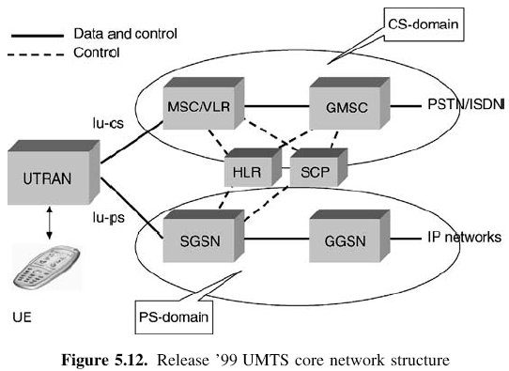
RELEASE ’99 CORE NETWORK ELEMENTS
Two domains of Release’99 core network
  Circuit Switched (CS) domain
  Packet Switched (PS) domain
The division comes from the different requirements for data depending on whether : it is real time (circuit switched) or non-real time (packet data)

Slide 45
  Registers
    HLR, VLR, EIR
  Service Control Point (SCP)
    the link for providing a particular service to end user

Slide 47
CS domain has the following elements
  Mobile Switching Centre (MSC), including Visitor Location Register (VLR)
  Gateway MSC (GMSC)

Slide 48
PS domain has the following elements
  Serving GPRS Support Node (SGSN)
    covers similar functions as MSC for packet data, including VLR type functionality
  Gateway GPRS Support Node (GGSN)
    connects PS core network to other networks, e.g. to the Internet

Slide 49
In addition to the two domains, the network needs various registers for proper operation
  Home Location Register (HLR)
  Equipment Identity Register (EIR)
    contains the information related to the terminal equipment
    can be used to, e.g., prevent a specific terminal from accessing the network

Slide 50
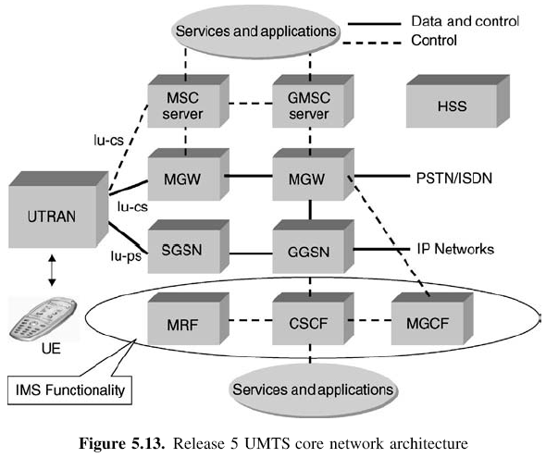

Slide 51
WHAT IS HANDOVER (HANDOFF)?
•Changing the point of connection while communicating
•In another words:
When a mobile user travels from one area of coverage or cell to another cell within a call’s duration the call should be transferred to the new cell’s base station.
Why handover is needed?
•Mobility
•User preferences

Slide 52
HANDOVER
When will a handoff occur?
•Initiated when received signal level drops below a certain threshold value.
•Not as simple as it seems
•Actually consider a time average of the received signal instead of the instantaneous level.

Slide 53
HANDOVER IN UMTS
For purely inter W-CDMA technology, there are three basic types of handover:
•Hard Handover
•Soft Handover
•Softer Handover

Slide 54
HANDOVER IN UMTS
There are following categories of handover (also referred to as handoff):
Hard Handover
Hard handover means that all the old radio links in the UE are removed before the new radio links are established.
Hard handover can be seamless or non-seamless. Seamless hard handover means that the handover is not perceptible to the user.
In practice a handover that requires a change of the carrier frequency (inter-frequency handover) is always performed as hard handover.

Slide 55
HARD HANDOVER
Break Before Make
•The network decides a handover is required dependent upon the signal strengths of the existing link, and the strengths of broadcast channels of adjacent cells.
•The link between the existing NodeB and the UE is broken.
•A new link is established between the new NodeB and the UE.

Slide 56
HANDOVER IN UMTS
Soft Handover
Soft handover means that the radio links are added and removed in a way that the UE always keeps at least one radio link to the UTRAN.
Soft handover is performed by means of macro diversity, which refers to the condition that several radio links are active at the same time.
Normally soft handover can be used when cells operated on the same frequency are changed.

Slide 57
SOFT HANDOVER
Occures when the ME is moving in the overlaping coverage area.
•The ME communicate and recieve the signals from the NodeB’s which their signals are overlaping.
•The rake reciever is needed in the UE (ME) to combine the two signals
•In the uplink , the best quality frame of the two signals is selected. The selection is made by the outer loop power control algorithm measurment.
•Negatives: It need to indicate rescources(capacity) on both NodeBs

Slide 58
HANDOVER IN UMTS
Softer handover
Softer handover is a special case of soft handover where the radio links that are added and removed belong to the same Node B (i.e. the site of co-located base stations from which several sector-cells are served.
In softer handover, macro diversity with maximum ratio combining can be performed in the Node B, whereas generally in soft handover on the downlink, macro diversity with selection combining is applied.

Slide 59
SOFT HANDOVER
In a soft handover, a terminal is connected simultaneously to more than one base station via several handover branches. The group of base stations communicating with the terminal during soft handover is called the active set.
Based on signal strength decisions involving various thresholds, branches can be added to or removed from the connection at any time, in other words base stations can be added to or removed from the active set. Such actions are referred to as ”active set update” procedures.

Slide 60
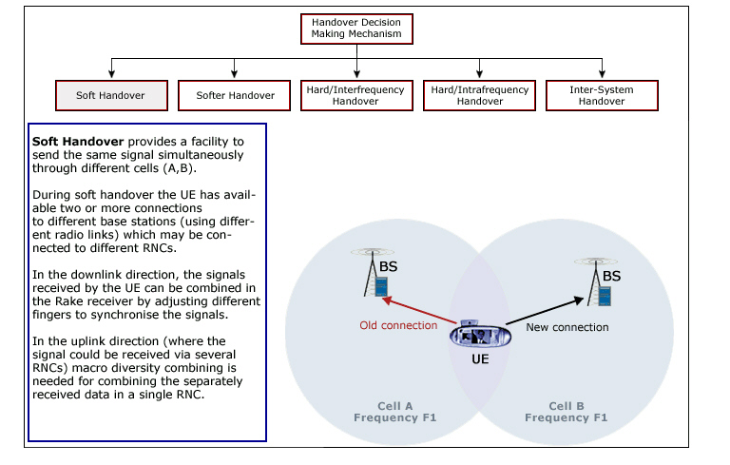
SOFT HANDOVER

